Slide 1
Rutgers AI Group
Lane Identification
Friday September 19th 2025

Slide 2
Datasets
Smartphone GPS Data
Trillions of points but uneven sampling
GPS points are binned to hexagons with 1 meter diameter to calculate point density
OpenStreetMap
Provides link centerlines (not always aligned correctly)
Provides number of lanes in each direction
Has many links with missing lane information

Slide 3
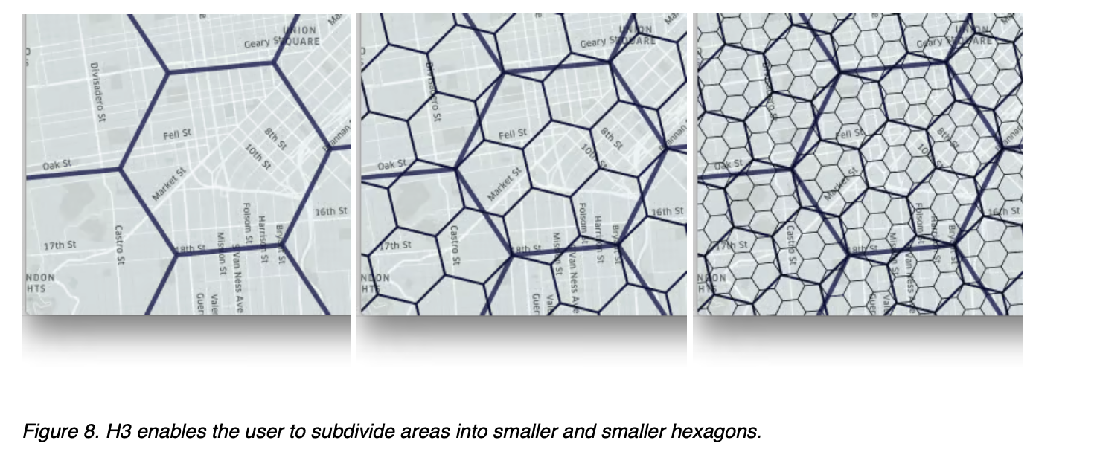
The hierarchical spatial grid used for binning
https://www.uber.com/blog/h3/

Slide 4
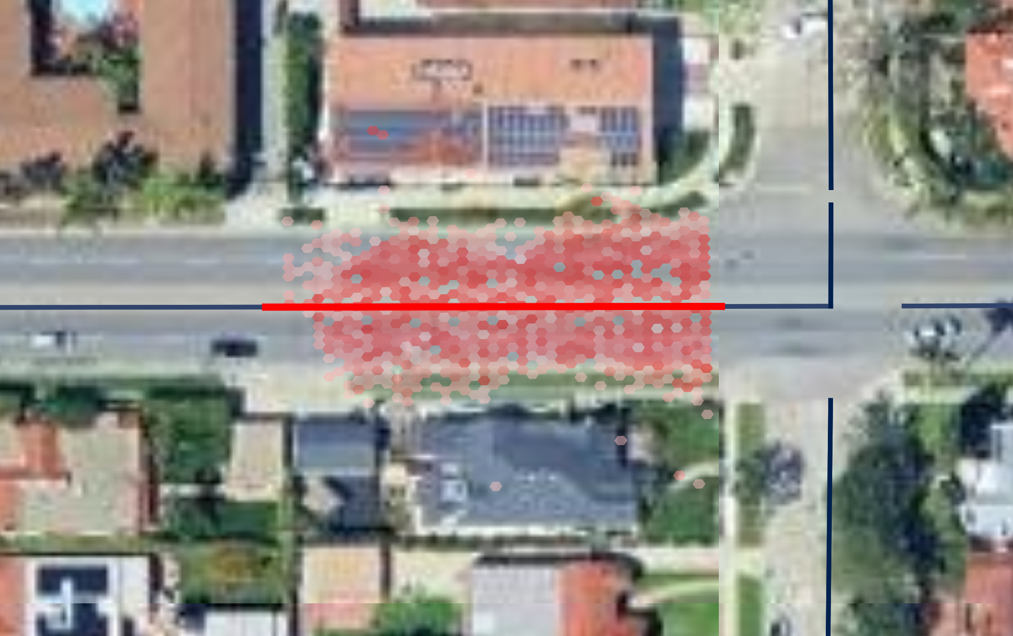
Dataset Sample

Slide 5
Random Forest
For every OSM link with lane information
Treat every link as a single cross section
Distance to centerline (distance_15, measured in diameters of hexagons level 15, approximately 1 meter)
Percentage of of GPS pings in the hexagon. The total for every row is 100%
One way or two way link indicator variable
Number of lanes from Open Street Map

Slide 6
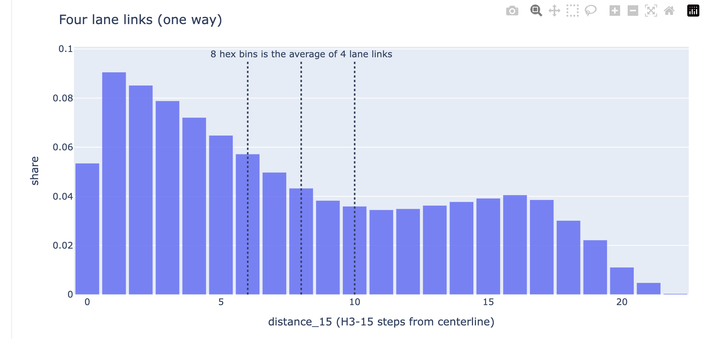
Cross section distribution of hexagon density

Slide 7
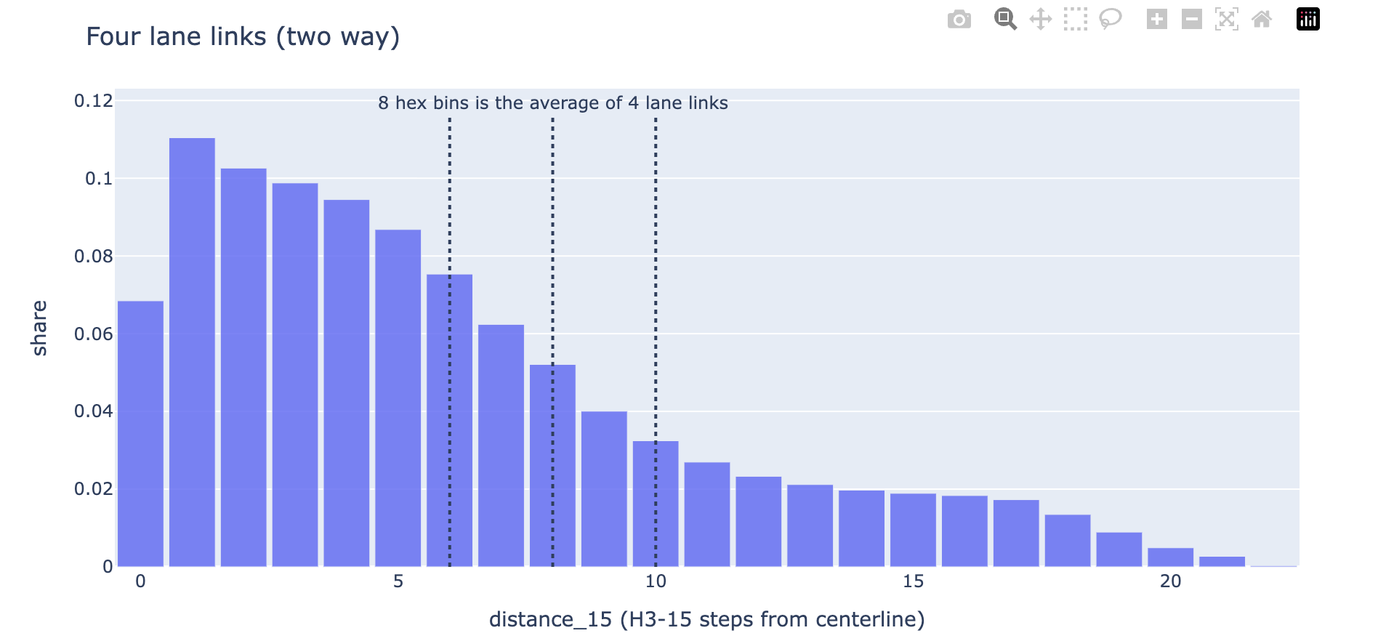
Cross section distribution of hexagon density (two way)

Slide 8
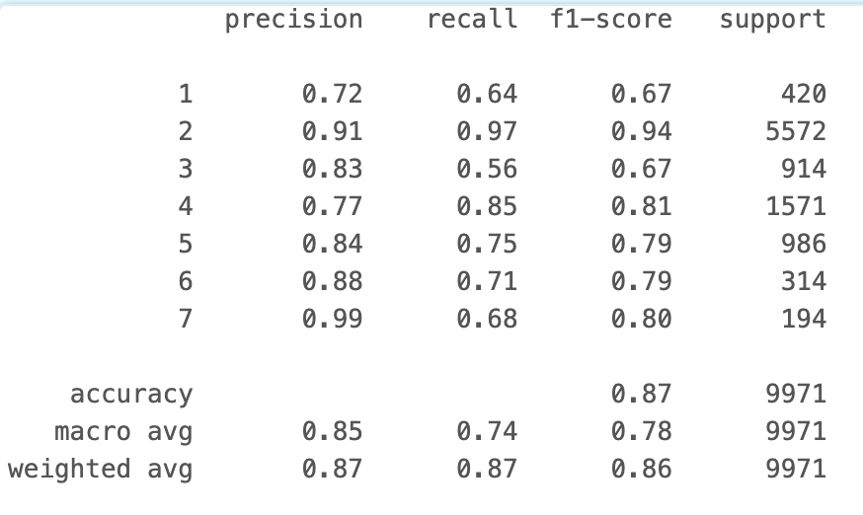
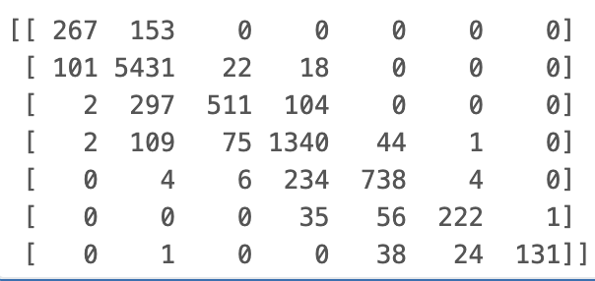
Random Forest Classifier (random sample)
Confusion Matrix
Lanes
Lanes
Lanes

Slide 9
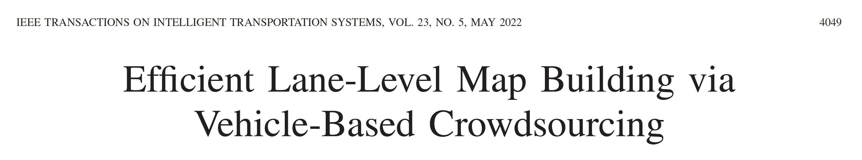
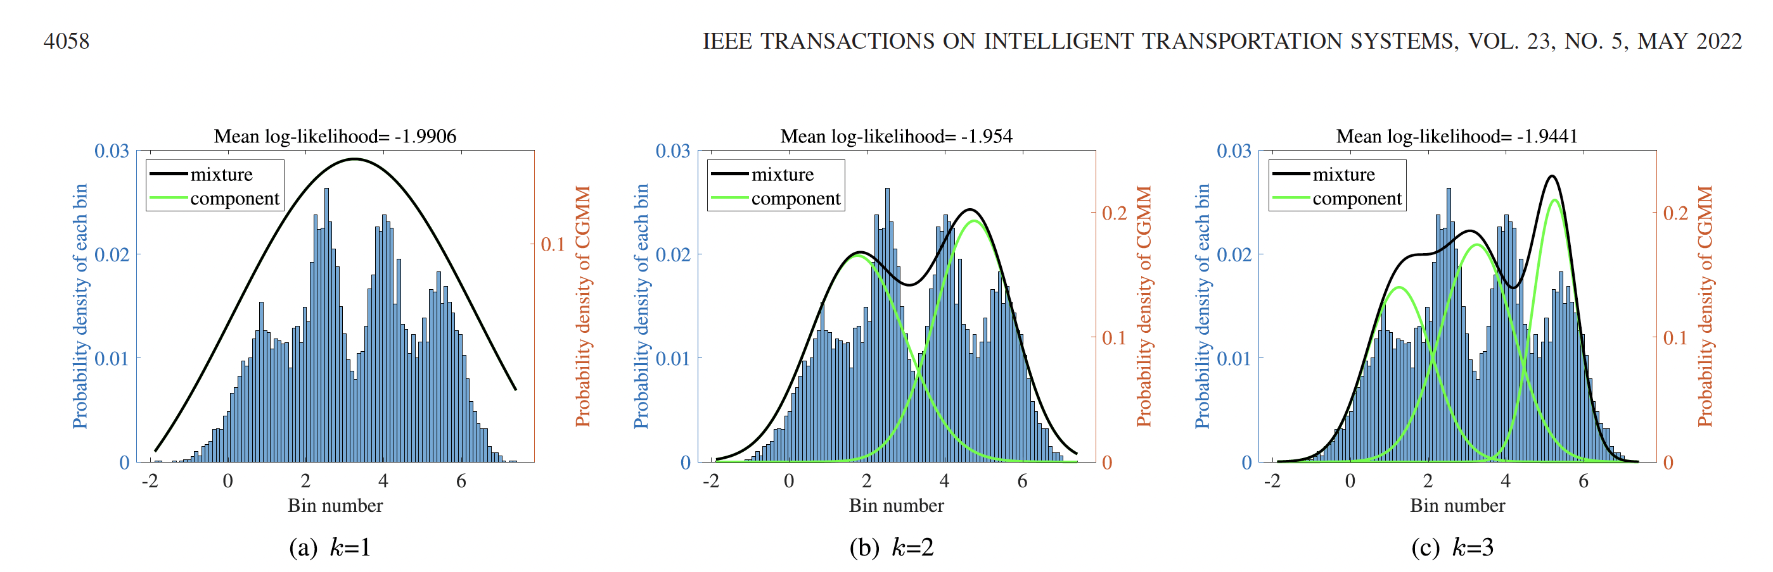
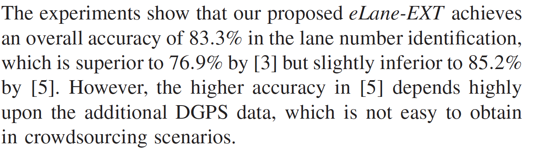
Literature (GMM Mixture)

Slide 10
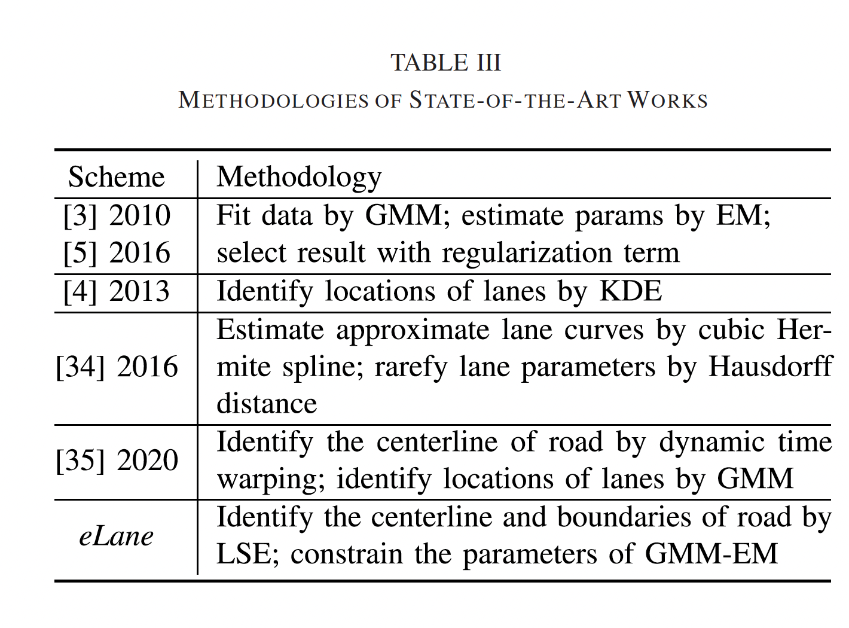
Literature

Slide 11
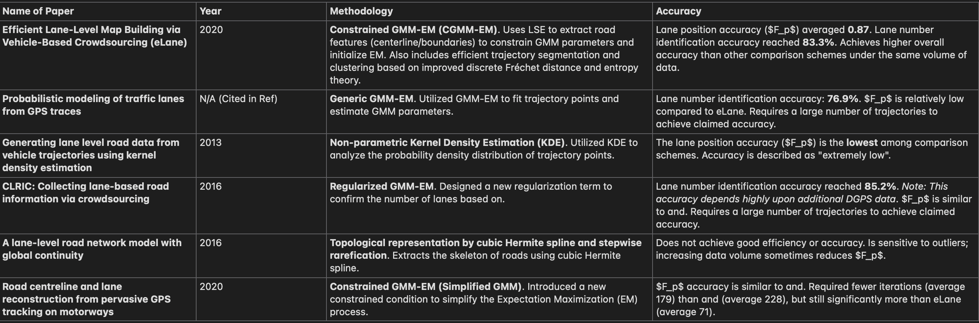
Summary of Relevant Research By Gemini

